Slide 1
Making Decisions

Slide 2
Learning Outcomes
Eight steps in the decision-making process
Four ways or perspectives of how managers make decisions.
Decisions types
Decision-making conditions
Decision-making Styles
How biases affect decision making
Notes:
Communication is the transfer and understanding of meaning. Note the emphasis on the transfer of meaning: If information or ideas have not been conveyed, communication hasn’t taken place. The speaker who isn’t heard or the writer whose materials aren’t read hasn’t communicated. More importantly, however, communication involves the understanding of meaning.
Communication encompasses both interpersonal communication—communication between two or more people—and organizational communication, which is all the patterns, networks, and systems of communication within an organization. Both types are important to managers.

Slide 3

What is a Decision?
Decision—a choice among two or more alternatives

Slide 4
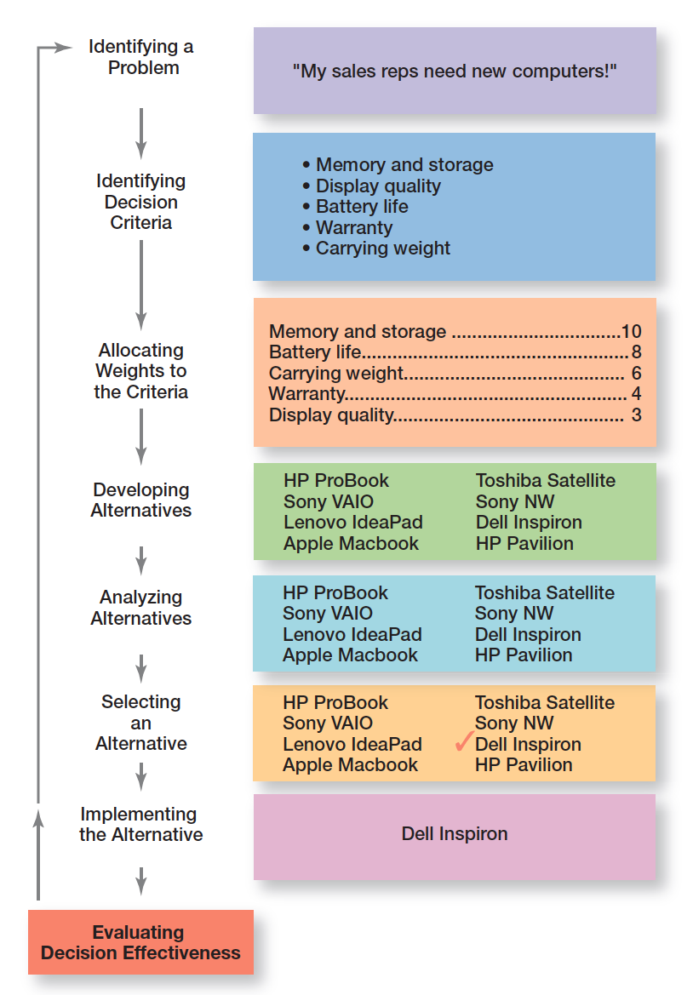
Decision Making Process

Slide 5
Important Decision Criteria
Criterion | Weight
Memory and storage | 10
Battery life | 8
Carrying weight | 6
Warranty | 4
Display quality | 3

Slide 6
Possible Alternatives
Laptop | Memory and Storage | Battery Life | Carrying Weight | Warranty | Display Quality
HP ProBook | 10 | 3 | 10 | 8 | 5
Lenovo IdeaPad | 8 | 5 | 7 | 10 | 10
Apple MacBook | 8 | 7 | 7 | 8 | 7
Toshiba Satellite | 7 | 8 | 7 | 8 | 7
Apple MacBook Air | 8 | 3 | 6 | 10 | 8
Dell Inspirion | 10 | 7 | 8 | 6 | 7
HP Pavilion | 4 | 10 | 4 | 8 | 10

Slide 7
Evaluation of Alternatives
Laptop | Memory and Storage | Battery Life | Carrying Weight | Warranty | Display Quality | Total
HP ProBook | 100 | 24 | 60 | 32 | 15 | 231
Lenovo IdeaPad | 80 | 40 | 42 | 40 | 30 | 232
Apple MacBook | 80 | 56 | 42 | 32 | 21 | 231
Toshiba Satellite | 70 | 64 | 42 | 32 | 21 | 229
Apple MacBook Air | 80 | 24 | 36 | 40 | 24 | 204
Dell Inspirion | 100 | 56 | 48 | 24 | 21 | 249
HP Pavilion | 40 | 80 | 24 | 32 | 30 | 206

Slide 8
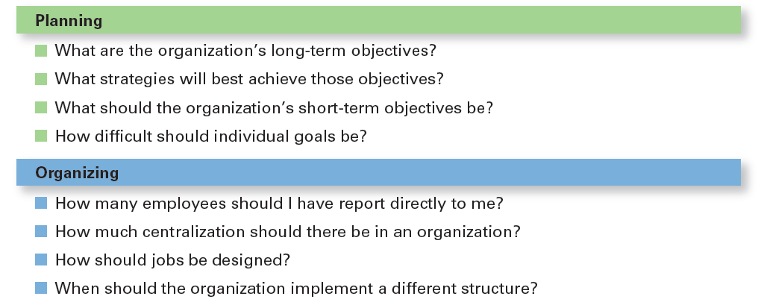
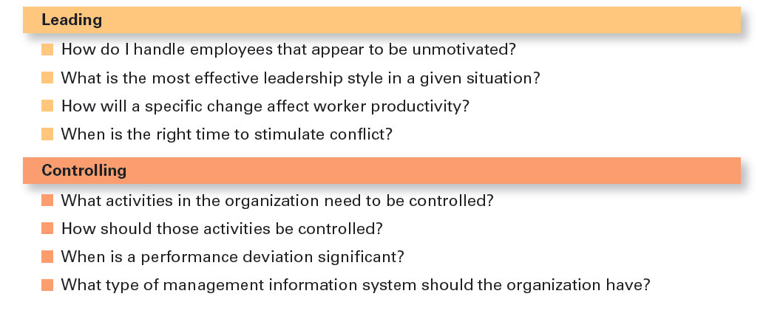
Decisions Managers May Make

Slide 9
Four perspectives how managers make decisions
Notes:
Communication is the transfer and understanding of meaning. Note the emphasis on the transfer of meaning: If information or ideas have not been conveyed, communication hasn’t taken place. The speaker who isn’t heard or the writer whose materials aren’t read hasn’t communicated. More importantly, however, communication involves the understanding of meaning.
Communication encompasses both interpersonal communication—communication between two or more people—and organizational communication, which is all the patterns, networks, and systems of communication within an organization. Both types are important to managers.

Slide 10
How you make decision….
You are founder & CEO of an Electric Car Manufacturing startup in the process to establish your operations to cater India and UK markets.
What all Decisions you may need to take?.....
Manufacture or Buy Components?
Which Supplier(s) to bring on board?
.
.
How will you make decision here?.....

Slide 11
Perspective 1:
Making Decisions: Rationality
We assume that managers will use Rational Decision-Making, will make logical and consistent choices to maximize value (after assessing all possible alternatives). Managers have all sorts of tools and techniques to help them be rational decision makers.
Assumptions of rationality:
  Rational decision maker is logical and objective
  Problem faced is clear and unambiguous
  Decision maker would have clear, specific goal and be aware of all alternatives and consequences
  The alternative that maximizes achieving this goal will be selected
  Decisions are made in the best interest of the organization
Notes:
We assume that managers will use rational decision-making; that is, they’ll make logical and consistent choices to maximize value. After all, managers have all sorts of tools and techniques to help them be rational decision makers. Managers aren’t always rational. What does it mean to be a “rational” decision maker? A rational decision maker would be fully objective and logical. The problem faced would be clear and unambiguous, and the decision maker would have a clear and specific goal and know all possible alternatives and consequences. Finally, making decisions rationally would consistently lead to selecting the alternative that maximizes the likelihood of achieving that goal.
These assumptions apply to any decision—personal or managerial. However, for managerial decision making, we need to add one additional assumption—decisions are made in the best interests of the organization. These assumptions of rationality aren’t very realistic and managers don’t always act rationally, but the next concept can help explain how most decisions get made in organizations.

Slide 12
Perspective 2:
Decision Making: Bounded Rationality
Bounded rationality: Managers make decisions rationally, but are limited (bounded) by their ability to process information.
  Managers Satisfice, rather than maximize: accepting solutions that are “good enough”.
  (Important to keep in mind that decision making is also influenced by the organization’s culture, internal politics, power considerations and by a phenomenon called escalation of commitment)
  Escalation of commitment: an increased commitment to a previous decision despite evidence it may have been wrong.
Notes:
A more realistic approach to describing how managers make decisions is the concept of bounded rationality, which says that managers make decisions rationally, but are limited (bounded) by their ability to process information. Because they can’t possibly analyze all information on all alternatives, managers satisfice, rather than maximize. That is, they accept solutions that are “good enough.” They’re being rational within the limits (bounds) of their ability to process information.
However, keep in mind that their decision-making is also likely influenced by the organization’s culture, internal politics, power considerations, and by a phenomenon called escalation of commitment, an increased commitment to a previous decision despite evidence that it may have been wrong.

Slide 13
Perspective 3:
Making Decisions: The Role of Intuition
Intuitive decision-making: making decisions on the basis of experience, feelings, and accumulated judgment.
Intuitive decision making can complement both rational and bounded rational decision making.
Notes:
What is intuitive decision-making? It’s making decisions on the basis of experience, feelings, and accumulated judgment. Researchers studying managers’ use of intuitive decision-making have identified five different aspects of intuition, which are described in Exhibit 2-6.

Slide 14
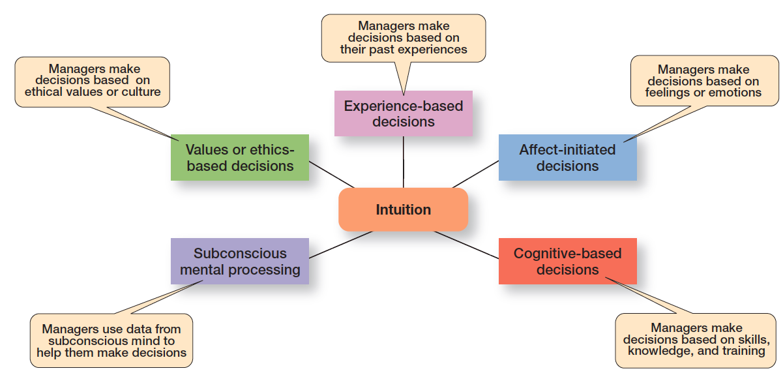
What is Intuition?
Shows the five different aspects of intuition identified by researchers studying managers’ use of intuitive decision-making.

Slide 15
Perspective 4:
Evidence-Based Management
Evidence-based management (EBMgt): the systematic use of the best available evidence to improve management practice. Use relevant and reliable evidence.
Four essential elements of EBMgt are:
The decision maker’s expertise and judgement
External evidence that’s been evaluated by the decision maker
Opinions, preferences, and values of those who have a stake in the decision
Relevant organizational (internal) factors such as context, circumstances, and organizational members.
Notes:
“Any decision-making process is likely to be enhanced through the use of relevant and reliable evidence, whether it’s buying someone a birthday present or wondering which new washing machine to buy.” That’s the premise behind evidence-based management (EBMgt), the “systematic use of the best available evidence to improve management practice.
EBMgt is quite relevant to managerial decision-making. The four essential elements of EBMgt are the decision maker’s expertise and judgment; external evidence that’s been evaluated by the decision maker; opinions, preferences, and values of those who have a stake in the decision; and relevant organizational (internal) factors such as context, circumstances, and organizational members.

Slide 16
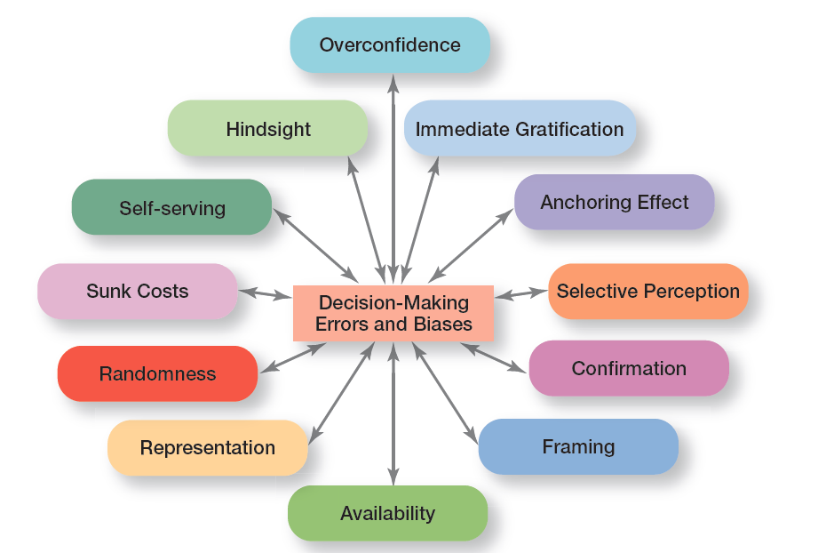
Common Decision-Making Biases

Slide 17
Decision-Making Biases and Errors (1 of 2)
Overconfidence Bias: holding unrealistically positive views of oneself and one’s performance
Immediate Gratification Bias: choosing alternatives that offer immediate rewards and avoid immediate costs
Anchoring Effect: fixating on initial information and ignoring subsequent information
Selective Perception Bias: selecting, organizing and interpreting events based on the decision maker’s biased perceptions
Confirmation Bias: seeking out information that reaffirms past choices while discounting contradictory information
Framing Bias: selecting and highlighting certain aspects of a situation while ignoring other aspects
Notes:
When decision makers tend to think they know more than they do or hold unrealistically positive views of themselves and their performance, they’re exhibiting the overconfidence bias.
The immediate gratification bias describes decision makers who tend to want immediate rewards and to avoid immediate costs. For these individuals, decision choices that provide quick payoffs are more appealing than those with payoffs in the future.
The anchoring effect describes how decision makers fixate on initial information as a starting point and then, once set, fail to adequately adjust for subsequent information. First impressions, ideas, prices, and estimates carry unwarranted weight relative to information received later.

Slide 18
Decision-Making Biases and Errors (2 of 2)
Availability Bias: losing decision-making objectivity by focusing on the most recent events
Representation Bias: drawing analogies and seeing identical situations when none exist
Randomness Bias: creating unfounded meaning out of random events
Sunk Costs Errors: forgetting that current actions cannot influence past events and relate only to future consequences
Self-serving Bias: taking quick credit for successes and blaming outside factors for failures
Notes:
The availability bias happens when decisions makers tend to remember events that are the most recent and vivid in their memory. The result? It distorts their ability to recall events in an objective manner and results in distorted judgments and probability estimates.
When decision makers assess the likelihood of an event based on how closely it resembles other events or sets of events, that’s the representation bias. Managers exhibiting this bias draw analogies and see identical situations where they don’t exist.
The randomness bias describes the actions of decision makers who try to create meaning out of random events. They do this because most decision makers have difficulty dealing with chance even though random events happen to everyone, and there’s nothing that can be done to predict them.

Slide 19
Types of Decisions
Structured problems: straightforward, familiar, and easily defined problems.
  Programmed decisions: repetitive decisions that can be handled by a routine approach.
  Types of Programmed Decisions
Procedure: a series of sequential steps used to respond to a well-structured problem
  Rule: an explicit statement that tells managers what can or cannot be done
  Policy: a guideline for making decisions
Notes:
Some problems are straightforward. The decision maker’s goal is clear, the problem is familiar, and information about the problem is easily defined and complete. Such situations are called structured problems because they’re straightforward, familiar, and easily defined. Because it’s not an unusual occurrence, there’s probably some standardized routine for handling it. This is what we call a programmed decision, a
repetitive decision that can be handled by a routine approach. Because the problem is structured, the manager doesn’t have to go to the trouble and expense of going through an involved decision process. The “develop-the-alternatives” stage of the decision-making process either doesn’t exist or is given little attention. Why? Because once the structured problem is defined, the solution is usually self-evident or at least reduced to a few alternatives that are familiar and have proved successful in the past.

Slide 20
Types of Decisions
Unstructured problems: problems that are new or unusual and for which information is ambiguous or incomplete
  Nonprogrammed decisions: unique and nonrecurring and involve custom made solutions
Notes:
Not all the problems managers face can be solved using programmed decisions. Many organizational situations involve unstructured problems, new or unusual problems for which information is ambiguous or incomplete. Whether to build a new manufacturing facility in China is an example of an unstructured problem.

Slide 21
Decision-Making Conditions
Certainty: a situation in which a manager can make accurate decisions because all outcomes are known.
  Risk: a situation in which the decision maker is able to estimate the likelihood of certain outcomes.
  Uncertainty: a situation in which a decision maker has neither certainty nor reasonable probability estimates available.
Notes:
The ideal situation for making decisions is one of certainty, a situation where a manager can make accurate decisions because the outcome of every alternative is known. For example, when Wyoming’s state treasurer decides where to deposit excess state funds, he knows exactly the interest rate offered by each bank and the amount that will be earned on the funds. He is certain about the outcomes of each alternative. As you might expect, most managerial decisions aren’t like this.
A far more common situation is one of risk, conditions in which the decision maker is able to estimate the likelihood of certain outcomes. Under risk, managers have historical data from past personal experiences or secondary information that lets them assign probabilities to different alternatives.
What happens if you face a decision where you’re not certain about the outcomes and can’t even make reasonable probability estimates? We call this condition uncertainty. Managers face decision-making situations of uncertainty. Under these conditions, the choice of alternative is influenced by the limited amount of available information and by the psychological orientation of the decision maker.

Slide 22
Managing Risk
Managers can use historical data or secondary information to assign probabilities to different alternatives
This is used to calculate expected value—the expected return from each possible outcome—by multiplying expected revenue by the probability of each alternative
Notes:
Under risk, managers have historical data from past personal experiences or secondary information that lets them assign probabilities to different alternatives.

Slide 23
Example: Expected Value
On the basis of last 10 years data
Event | Expected Revenues | Probability | Expected Value of Each Alternative
Heavy snowfall | $850,000 | 0.3 | $255,000
Normal snowfall | $725,000 | 0.5 | $362,000
Light snowfall | $350,000 | 0.2 | $70,000
Blank | Blank | Total expected revenue: | $687,500

Slide 24
Uncertainty
Under uncertainty, the choice of alternatives is influenced by the limited amount of available information and by psychological orientation of the decision maker.
An optimistic manager will follow a maximax choice (maximizing the maximum possible payoff).
A pessimist will follow a maximin choice (maximizing the minimum possible payoff).
A manager who desires to minimize his maximum “regret” will opt for a minimax choice.

Slide 25
Example: Decision making under uncertainty
Payoff Matrix
Visa Marketing Strategy (in millions of dollars | MasterCard CA 1 | MasterCard CA 2 | MasterCard CA 3
Strategy 1 | 13 | 14 | 11
Strategy 2 | 9 | 15 | 18
Strategy 3 | 24 | 21 | 15
Strategy 4 | 18 | 14 | 28
Regret Matrix
Visa Marketing Strategy (in millions of dollars | MasterCard CA 1 | MasterCard CA 2 | MasterCard CA 3
Strategy 1 | 11 | 7 | 17
Strategy 2 | 15 | 6 | 10
Strategy 3 | 0 | 0 | 13
Strategy 4 | 6 | 7 | 0
shows the regret for each category, which is found by subtracting all possible payoffs in each category from the maximum possible payoff for each given event, in this case for each competitive action.

Slide 26
Decision-making Styles
The way a person approaches to decision making is likely affected by his or her thinking style. Thinking style reflects two things:
1) the source of information you tend to use (external data and facts OR internal sources such as feelings and intuition)
2) whether you process that information in a linear way (rational, logical, analytical) OR a nonlinear way (intuitive, creative, insightful)
Linear thinking Style: a person’s preference for using external data and facts and processing this information through rational, logical thinking to guide decisions and actions.
Nonlinear thinking Style: a preference for internal sources of information (feelings and intuition) and processing this information with internal insights, feelings, and hunches to guide decisions and actions.

Slide 27
Guidelines for Making Effective Decisions
Understand cultural differences
Create standards for good decision making
Know when it’s time to call it quits
Use an effective decision-making process
Develop your ability to think clearly
Design thinking: approaching management problems as designers approach design problems. Understanding the problem first is the key
Big data: the vast amount of quantifiable data that can be analyzed by highly sophisticated data processing
Notes:
Decision-making is serious business. Your abilities and track record as an effective decision maker will determine how your organizational work performance is evaluated and whether you’ll be promoted to higher and higher positions of responsibility. Below are some guidelines to help you be a better decision maker.
Understand cultural differences. Managers everywhere want to make good decisions. However, is there only one “best” way worldwide to make decisions? Or does the “best way depend on the values, beliefs, attitudes, and behavioral patterns of the people involved?”
Create standards for good decision making. Good decisions are forward-looking, use available information, consider all available and viable options, and do not create conflicts of interest.
Know when it’s time to call it quits. When it’s evident that a decision isn’t working, don’t be afraid to pull the plug.
Use an effective decision-making process.
Build an organization that can spot the unexpected and quickly adapt to the changed environment.

Slide 28
Planning Work Activities

Slide 29
What is Planning?
Planning: primary management function that involves setting goals, establishing strategies for achieving those goals, and developing plans to integrate and coordinate work activities.
It involves two important aspects:
Goals (objectives): desired outcomes or targets
Plans: documents that outline how goals are going to be met
Notes:
Planning involves defining the organization’s goals, establishing strategies for achieving those goals, and developing plans to integrate and coordinate work activities. It’s concerned with both ends (what) and means (how).
When we use the term planning, we mean formal planning. In formal planning, specific goals covering a specific time period are defined. These goals are written and shared with organizational members to reduce ambiguity and create a common understanding about what needs to be done. Finally, specific plans exist for achieving these goals.

Slide 30
Why Do Managers Plan?
Provides direction
Reduces uncertainty
Minimizes waste and redundancy
Establishes the goals and standards for controlling

Slide 31
Approaches to Setting Goals
Traditional goal-setting: an approach to setting goals in which top managers set goals that then flow down through the organization and become sub-goals for each organizational area
  Means-ends chain: an integrated network of goals in which the accomplishment of goals at one level serves as the means for achieving the goals, or ends, at the next level
Management by objectives (MBO): a process of setting mutually agreed upon goals and using those goals to evaluate employee performance
Notes:
Turning broad strategic goals into departmental, team, and individual goals can be a di cult and frustrating process.
Another problem with traditional goal-setting is that when top managers define the organization’s goals in broad terms—such as achieving “sufficient” profits or increasing “market leadership”—these ambiguous goals have to be made more specific as they ow down through the organization. Managers at each level define the goals and apply their own interpretations and biases as they make them more specific. However, what often happens is that clarity is lost as the goals make their way down from the top of the organization to lower levels.

Slide 32
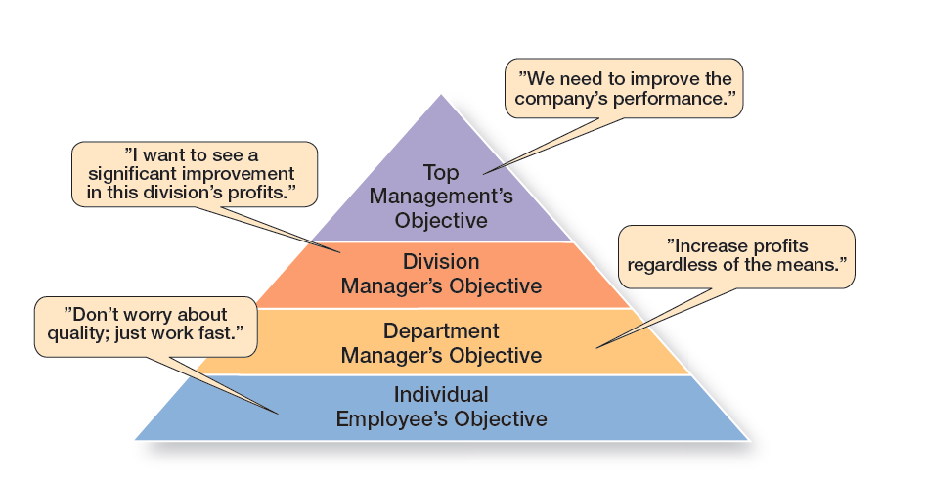
The Downside of Traditional Goal-Setting
Exhibit 8-2 illustrates what can happen as the goals make their way down from the top of the organization to lower levels.
Notes:
What often happens is that clarity is lost as the goals make their way down from the top of the organization to lower levels. Exhibit 8-2 illustrates what can happen.

Slide 33
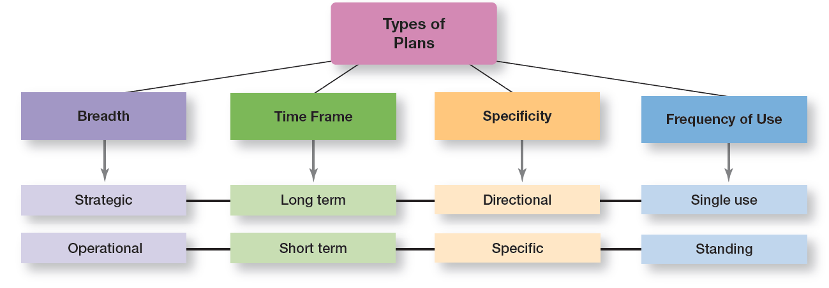
Types of Plans

Slide 34
Strategic and Operational Plans
Strategic plans: plans that apply to the entire organization and establish the organization’s overall goals
Operational plans: plans that encompass a particular operational area of the organization
Notes:
The most popular ways to describe organizational plans are breadth (strategic versus operational), time frame (short-term versus long-term), specificity (directional versus specific), and frequency of use (single use versus standing).
Strategic plans are plans that apply to the entire organization and establish the organization’s overall goals. Plans that encompass a particular operational area of the organization are called operational plans. These two types of plans differ because strategic plans are broad while operational plans are narrow.

Slide 35
Long-term and Short-term Plans
Long-term plans: plans with a time frame beyond three years
Short-term plans: plans covering one year or less
Notes:
Any time period in between would be an intermediate plan. Although these time classifications are fairly common, an organization can use any planning time frame it wants.

Slide 36
Specific and Directional Plans
Specific plans: plans that are clearly defined and leave no room for interpretation
Directional plans: plans that are flexible and set out general guidelines
Notes:
Specific plans are clearly defined and leave no room for interpretation. A specific plan states its objectives in a way that eliminates ambiguity and problems with misunderstanding.
Directional plans are flexible plans that set out general guidelines. They provide focus but don’t lock managers into specific goals or courses of action.

Slide 37
Single-use and Standing Plans
Single-use plan: a one-time plan specifically designed to meet the needs of a unique situation
Standing plan: ongoing plan that provide guidance for activities performed repeatedly
Notes:
Some plans that managers develop are ongoing while others are used only once. A single-use plan is a one-time plan specifically designed to meet the needs of a unique situation.
In contrast, standing plans are ongoing plans that provide guidance for activities performed repeatedly. Standing plans include policies, rules, and procedures.

Slide 38
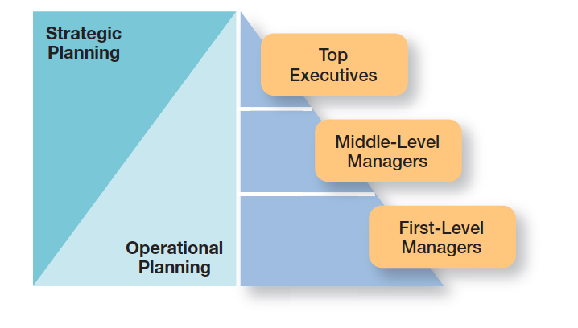
Planning and Organizational Level
Two Approaches to Developing Plans:
Top level managers assisted by Formal Planning department
Involve more organizational members in the process

Slide 39
How Can Managers Plan
Effectively in Dynamic Environments?
Develop plans that are specific but flexible
Keep planning even when the environment is uncertain
Allow lower organizational levels to set goals and develop plans
Notes:
In an uncertain environment, managers should develop plans that are specific, but flexible. Although this may seem contradictory, it’s not. To be useful, plans need some specificity, but the plans should not be set in stone. Managers need to recognize that planning is an ongoing process. The plans serve as a road map, although the destination may change due to dynamic market conditions.
Keep in mind, also, that even when the environment is highly uncertain, it’s important to continue formal planning in order to see any effect on organizational performance. It’s the persistence in planning that contributes to significant performance improvement. Why? It seems that, as with most activities, managers “learn to plan,” and the quality of their planning improves when they continue to do it.
Finally, make the organizational hierarchy flatter to effectively plan in dynamic environments. This means allowing lower organizational levels to set goals and develop plans because there’s little time for goals and plans to ow down from the top. Managers should teach their employees how to set goals and to plan and then trust them to do it.

Slide 40
Thank you

